Slide 1
2023: Overview and Achievements

Slide 2

Introduction
As the year draws to a close, everyone at WAVE is reflecting on a year filled with exceptional accomplishments, projects, and a commitment to sustainable development. From industry recognition to successful project completions, WAVE demonstrated their expertise and dedication to delivering outstanding results.
In 2023, WAVE Ltd continued its transformative journey as a fully Employee-Owned business, a visionary move initiated three years ago. This bold decision has empowered every employee, fostering a collective dedication to excellence and securing our future successes. As one of the few fully Employee-Owned businesses today, WAVE takes great pride in this achievement. Throughout the year, WAVE experienced remarkable growth and success, attracting new customers and expanding our services to all aspects of HVAC design, in addition to our expertise in refrigeration.
As we reflect on the achievements of this year, it fills us with great pleasure to highlight some of the remarkable milestones we have accomplished along the way.

Slide 3
Section 1: Achievements
2023: Timeline
12th June
Chris Parker- Elected Member of Institution of Mechanical Engineers
3rd July
Shortlisted for 3 awards at 2023 RAC Cooling Awards
16th November
Internal Promotion - Gokul Divakaran
16th June
Winner- Digital HVAC&R award -ASHRAE UK Technology Awards 2023
21st September
Caitlin Earle Finalist- Student of The Year RAC Cooling Awards
7th December
Caitlin Earle Silver Winner ACR & Heat Pump Trainee of the year awards

Slide 4
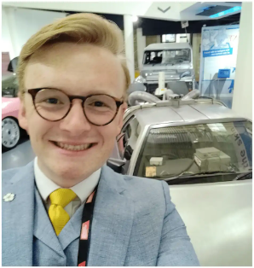
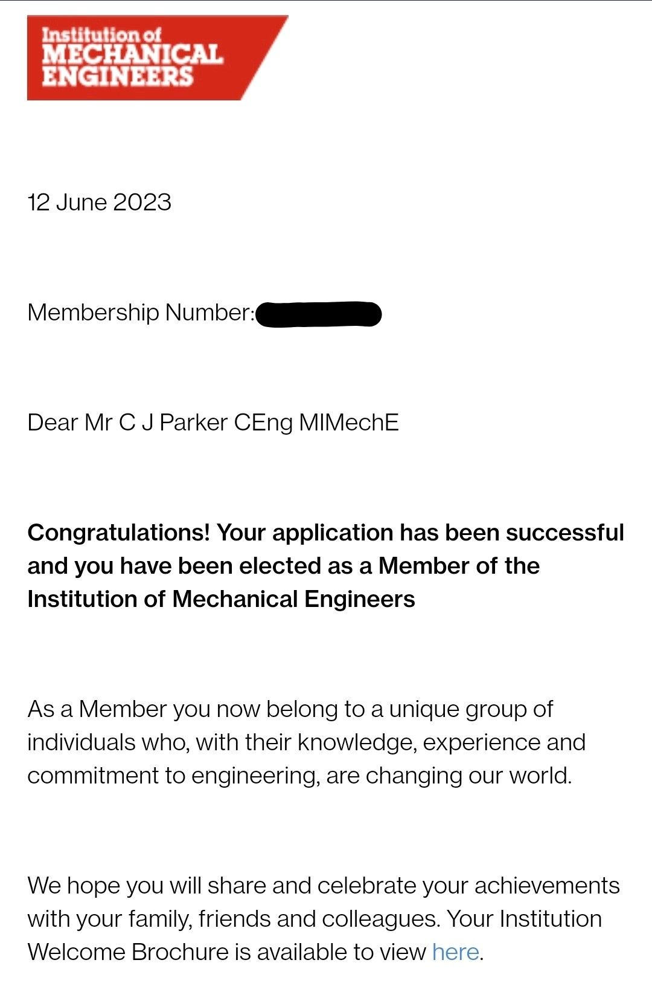
Individual Achievement: Chris Parker
Chartership Institute of Mechanical Engineers
At WAVE being an employee-owned company, we value individual accomplishments to the same degree as company-wide performance.
On the 12th June 2023 Chris Parker was accepted as a Chartered Engineers at the Institute of Mechanical Engineers.
This remarkable accomplishment is a testament to Chris’ unwavering dedication, exceptional knowledge, and relentless pursuit of excellence.
Chris also managed to achieve this significant milestone four years ahead of his own personal goal.
WAVE will continue to support Chris in his professional journey and look forward to witnessing his continued growth and accomplishments.

Slide 5
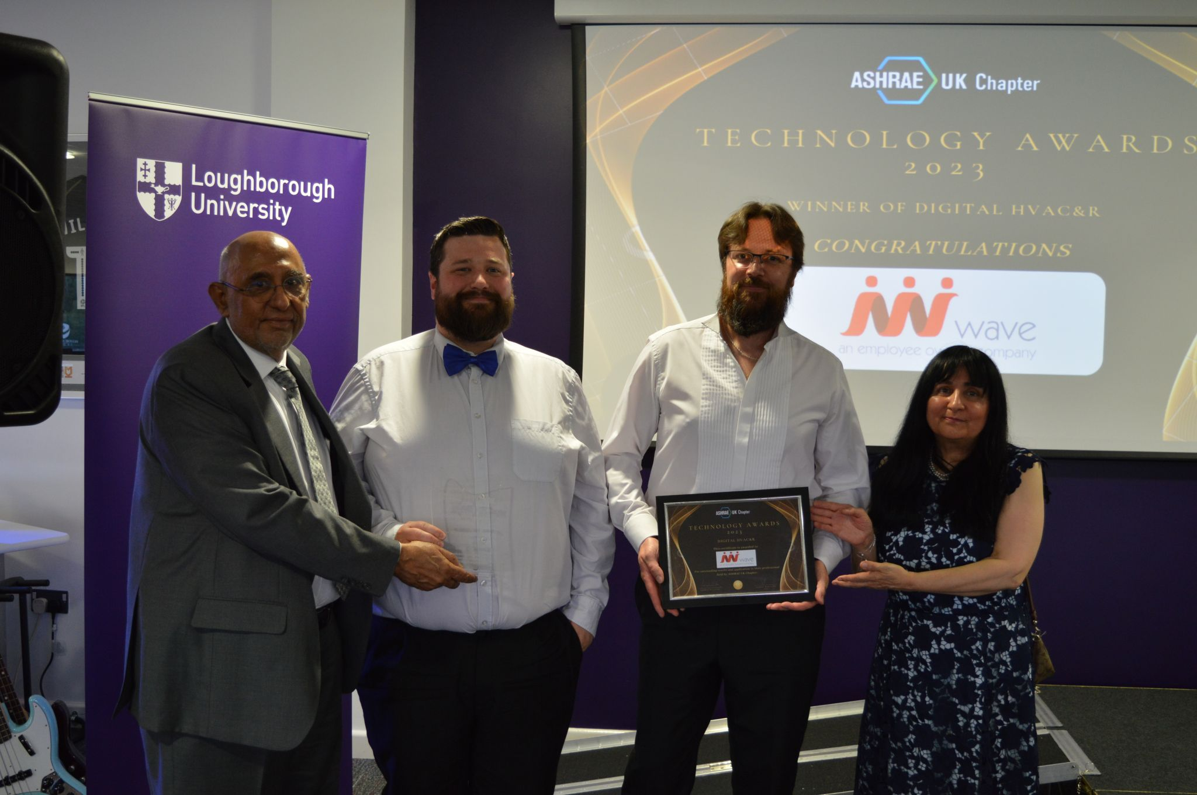

Winner- Digital HVAC&R Award
ASHRAE UK Technology Awards 2023
On the 16th June 2023, WAVE attended the first ASHRAE UK Technology Awards.
We were selected as a Winner in the Digital HVAC&R category for our theoretical simulation modelling software.
This software can simulate real-world refrigeration systems and heat pumps, making it an innovative solution for evaluating, analysing and designing heat transfer systems.
Our team has relentlessly worked towards finding sustainable and efficient solutions for the HVAC&R industry and this award is recognition of that hard work and effort.

Slide 6

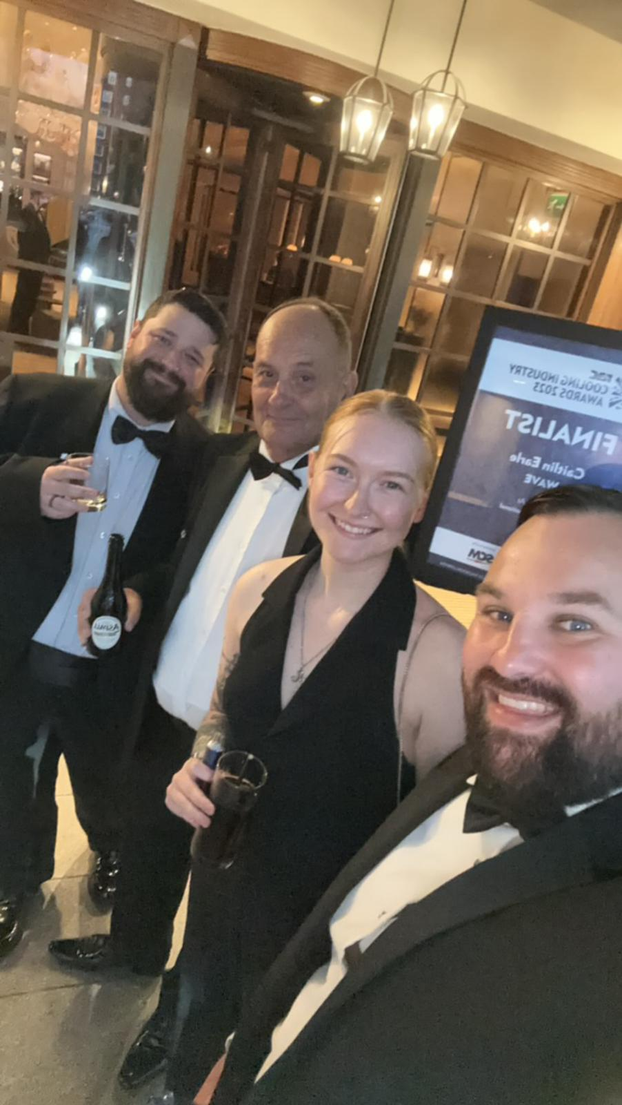
Shortlisted
RAC Cooling Awards
WAVE Refrigeration was been selected as a finalist for not one, not two, but THREE prestigious awards at the 2023 RAC Cooling Industry Awards.
Being selected as a finalist for the Refrigeration Innovation of the Year award showcases our commitment to pushing the envelope in developing cutting-edge refrigeration solutions.
Being nominated for the Small Company Achievement of the Year award is a testament to our unwavering determination and perseverance. As a nimble and agile company, we have successfully overcome numerous challenges to position ourselves as a force to reckon with.
WAVE were also thrilled to be a finalist for the Diversity & Inclusion award. We are committed to fostering an inclusive and equitable workplace environment where different perspectives thrive.

Slide 7
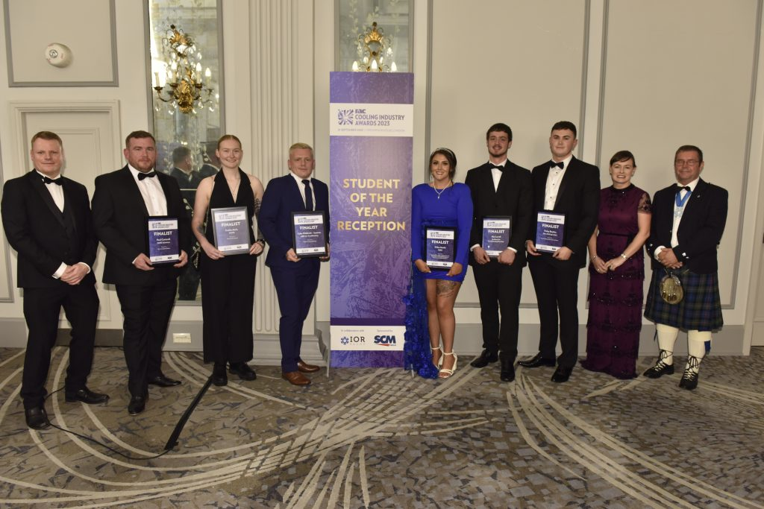

Caitlin Earle - Finalist
RAC and IOR National Student of the Year
Caitlin was selected as one of 8 finalists for the RAC and IOR National Student of the Year award at the 2023 RAC Cooling Awards.
The judges were impressed by Caitlin's workplace experience, and the trust put in her by employers to help manage project work. She was also recognised for an engaging face-to-face meeting
Caitlin has demonstrated a strong commitment to sustainability. Her role as a refrigeration consultant involves guiding customers towards achieving carbon equivalent emissions reductions. She has actively contributed to energy regressions, feasibility studies, and commercial initiatives, all with the goal of reducing overall emissions in commercial environments.

Slide 8
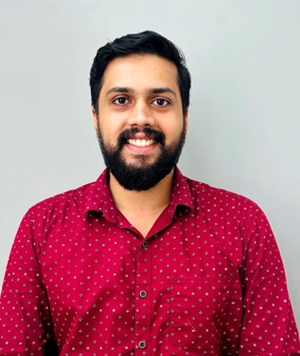
Promotion- Gokul Divakaran
Business Manger (India)
Gokul was the natural candidate to be promoted and lead the Indian team. As due to continued growth in 2023 we have expanded our Indian team.
With a successful tenure of six years at WAVE, Gokul has consistently proven his worth. He joined the company in December 2017 as a Trainee Design Engineer and has shown remarkable progression. Over the years, he steadily climbed the ladder, excelling in roles such as Design Engineer and Consultant.
Gokul has a Master of Business Administration (MBA) degree and a B.Tech in Mechanical Engineering. He is a member of the Institute of Refrigeration and the Indian Society of Heating, Refrigerating, and Air Conditioning Engineers (ISHRAE), demonstrating his dedication to staying at the forefront of his industry.

Slide 9
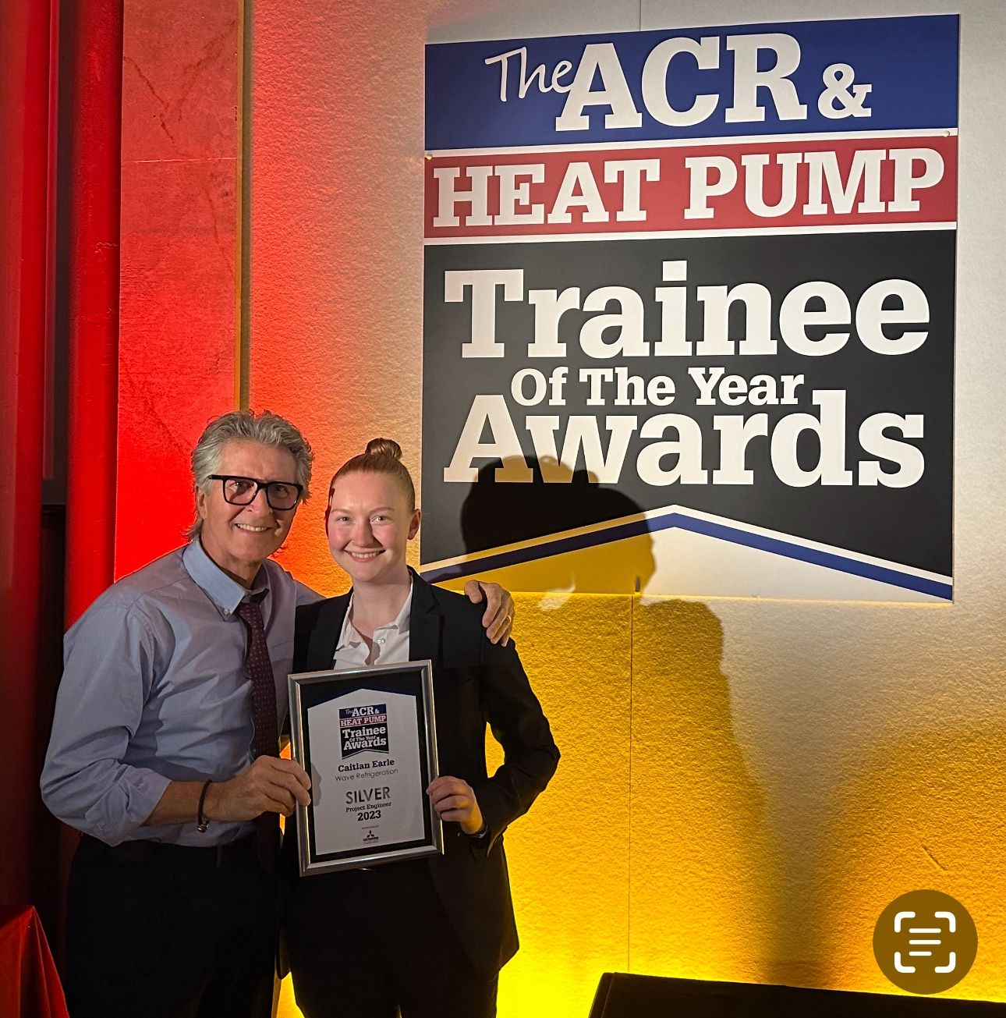
Caitlin Earle – Sliver Winner
The ACR & Heat Pump Trainee of the Year Awards
Caitlin Earle was awarded the Silver Winner in the highly esteemed Project Engineer category at the 2023 ACR & Heat Pump Trainee of the Year Awards , held at the Emirates Old Trafford on the 7th of December.
Caitlin has actively contributed to each project, demonstrating her ability to manage various aspects of the project lifecycle, from scoping and design to delivery and evaluation. The focus of sustainability is a large factor in what it means to be a refrigeration consultant.
This prestigious award serves as a testament to the exemplary work ethic and exceptional results that Cat consistently delivers.

Slide 10
Section 2: Projects and Events
2023: Schemes completed by our Projects & Engineering Teams
In 2023, WAVE undertook various significant projects and delivered exceptional work across multiple sectors. One of the major achievements was the successful completion of 60 large-scale projects for Aldi. These projects included initiatives such as Project Fresh, New stores, and store extensions. Additionally, WAVE also handled 69 smaller projects for Aldi, Including equipment replacements and cold room extensions.
WAVE collaborated with Bidfood and contributed to the design and support of seven projects. This involved aiding maintenance tender, conducting site condition reviews, and evaluating contractor performances.
WAVE showcased its expertise by conducting a comprehensive design and efficiency review of refrigeration and heat pump technologies for a major food retailer for their range of convenience stores.
The company also played a critical role in assisting many installation contractors in designing and delivering refrigeration and HVAC projects for prominent food and high street retailers.
WAVE also extended its services to new customers by assisting with PESR and PSSR compliance for refrigeration and heat pump installations. This exemplified the company's dedication to ensuring industry compliance and safety standards.

Slide 11
Section 2: Projects and Events
2023: Timeline
23rd May
WAVE visit compressor manufacturer Dorin
14th to 15th September
Cold Chain Live Event- Liverpool
27th September
Alan Saban presents at RAC “Store of the Future” event
26th June
World refrigeration Day – Ice Challenge
18th September
Mike Gittoes wites article on “The Power of Synergy in Building Services” in MBS Magazine
12th to 14th October
WAVE Attend Refcold India 2023

Slide 12
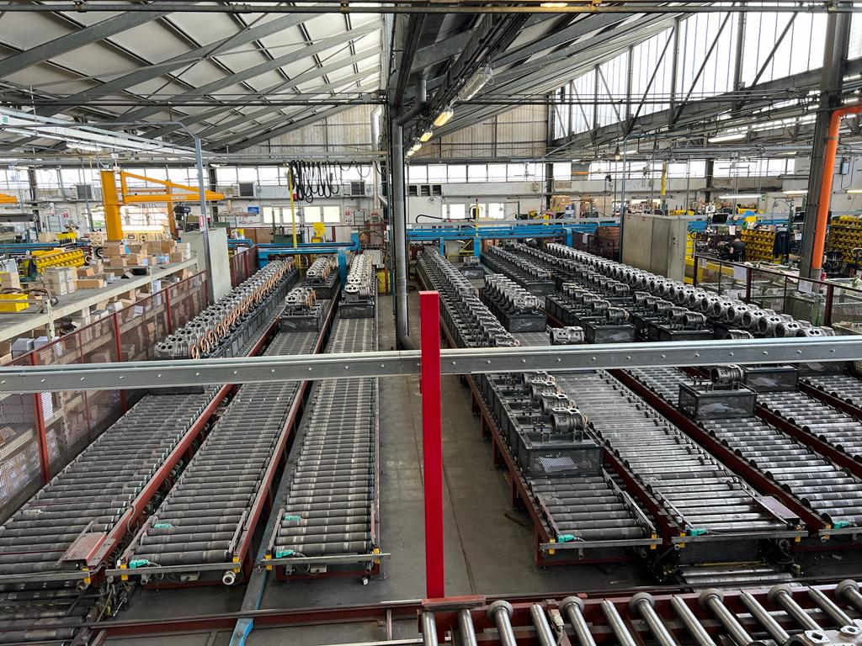
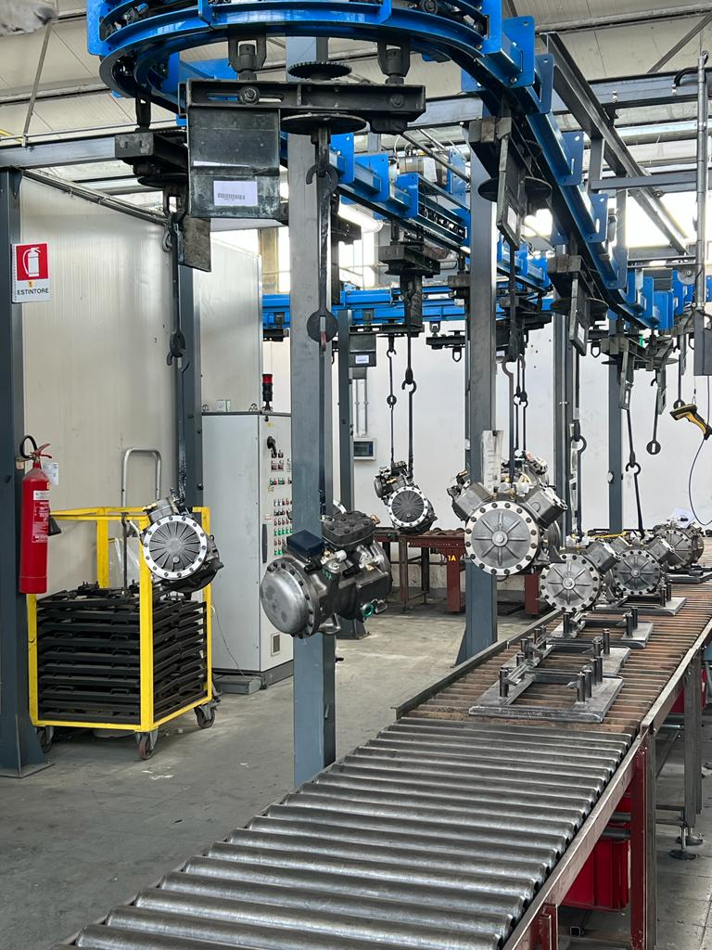
WAVE visit compressor manufacturer Dorin
24th March 2023 – Florence, Italy
Mark Williams Wave's Managing Director and Tim Simpson Project Consultant & Aldi account manager visited leading compressor manufacturer, Dorin, to sign an extended warranty agreement for a major food retail client.
Dorin has over 100 years of experience and is known for designing and producing high-quality compressors. Their commitment to sustainability and innovative technologies impressed Mark and Tim.
Dorin's compressors go through rigorous testing processes, including pressure testing, leak testing, electrical testing, and monitoring of run amps and pressures. Compressors are also coated to withstand salt spray testing.
The visit provided Wave with valuable insights and knowledge that they can use to offer cutting-edge solutions to clients. Gratitude was expressed towards Dorin for their hospitality and the opportunity to see their state-of-the-art facilities and learn from their experts.

Slide 13
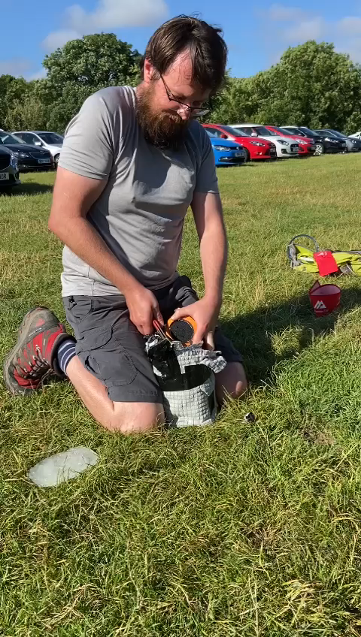
World Refrigeration Day – Ice Challenge
26th June 2023 – Horton-in-Ribblesdale
WAVE were a returning sponsor World Refrigeration Day 2023. To celebrate this event, Alan Saban, Yousaf Mohammed, Caitlin Earle, Sam Cameron took part in a unique challenge to put their skills to the test!
The team manufactured their own insulated boxes using materials that are commonly found in the kitchen. Then, had to carry them through the grueling 24-mile Yorkshire 3 peaks. The winner was the person who had the most ice back at then end of the walk.
Alan took home the prize, with a whopping 320g of ice left by the end of the challenge. Sam came in a close second with 280g, followed by Yousaf with 194g and Caitlin unfortunately had no ice remaining, but we applauded her effort nonetheless!

Slide 14
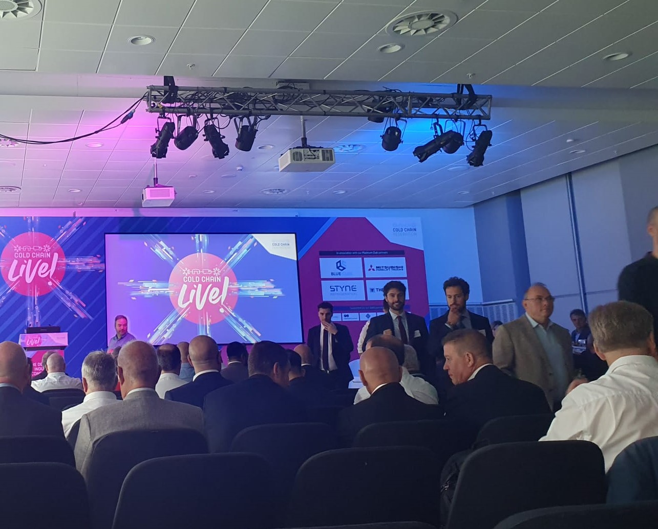

Cold Chain Live
14th to 15th September - ACC Liverpool
Mike Gittoes and Chris Parker from WAVE will be attended this year’s highly anticipated Cold Chain Live 2023 event. The sold-out conference took place on 14th and 15th of September at the ACC Liverpool. Organised by the Cold Chain Federation, the focus of this year’s event was on Resilience and Opportunity.
Mike and Chris will used their considerable experience to actively engage in panel discussions, workshops, and knowledge-sharing sessions, offering valuable insights and learning from other industry experts.
WAVE’s participation at Cold Chain Live further demonstrates our proactive approach in pursuing resilient future proof solutions.

Slide 15
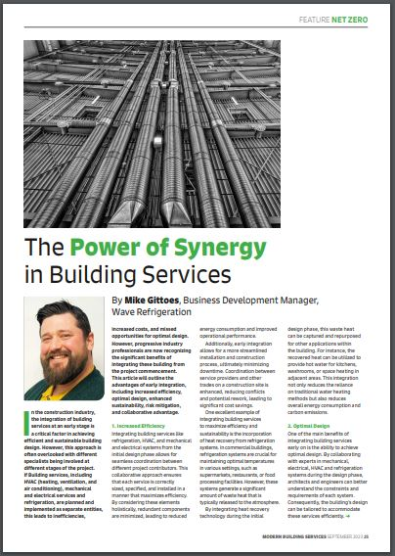

MBS Article- The Power of Synergy In building Services
18th September – In print and Online
Mike Gittoes had his insightful article published in the September 2023 edition of Modern Building Services Magazine.
The article titled the “The Power of Synergy in Building Services,” sheds light on the advantages of early integration of building services , highlighting the transformative impact it can have on various aspects of a construction project.
The article concludes that having a joined-up approach for refrigeration, HVAC, electrical, and mechanical services right from the start of a project creates numerous advantages such as Optimal Design, Enhanced Sustainability, Risk Mitigation, and Collaborative Advantage.

Slide 16
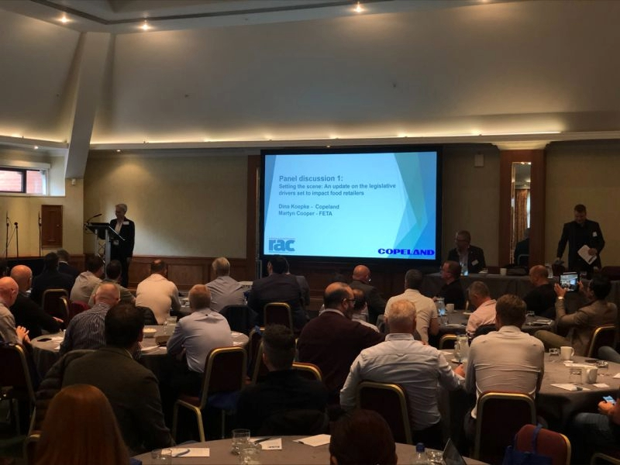

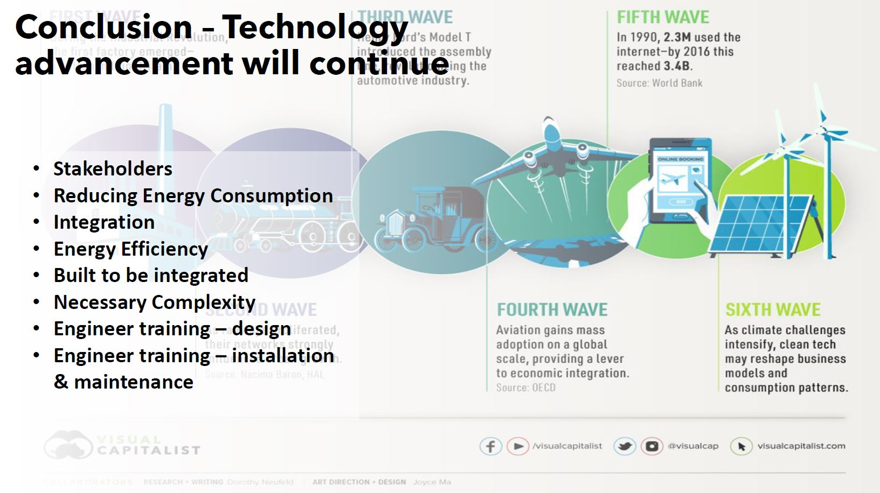
Alan Saban presents at RAC “Store of the Future” event
27th September – National Motorcycle Museum Birmingham
Alan Saban, Engineering Director of WAVE presented as part of a flagship panel at the RAC event sponsored by Copeland.
The presentation highlighted WAVE’s thoughts of how food retail stores of the future could be optimised to help achieve net zero, reduce energy consumption and continue to meet the evolving regulatory landscape.
Alan’s presentation emphasized the crucial importance of integrating building services, implementing effective maintenance practices, and providing necessary training in the evolving landscape of food retail.

Slide 17
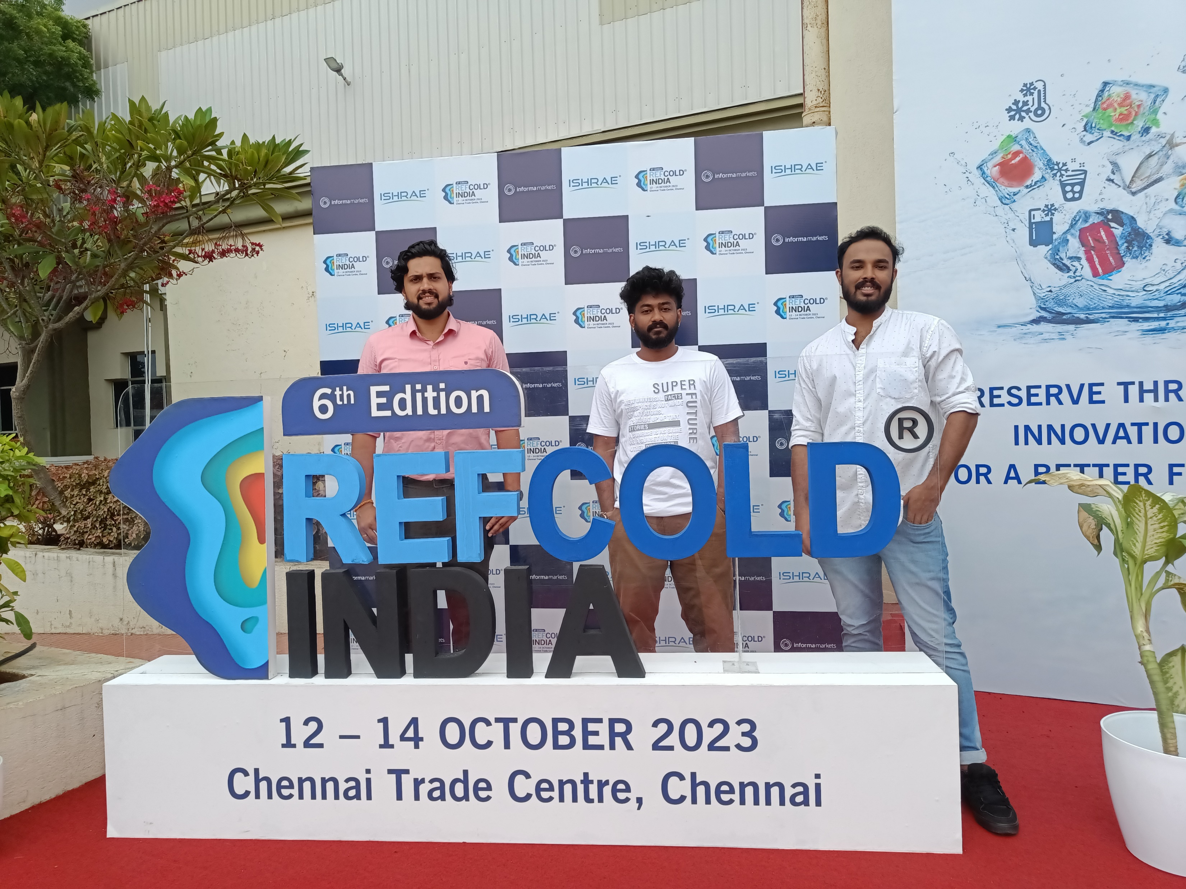
WAVE Attend Refcold India 2023
12th to 14th October – Chennai Trade Centre, India
Gokul, Siva, and Nandu from the WAVE India team had the incredible opportunity to attend the renowned Refcold India event in Chennai.
Our team actively participated in knowledge exchange sessions, eagerly sharing their expertise and insights. It was a fantastic opportunity to learn from our peers, gaining inspiration from their innovative approaches.
The event sparked inspiration and ignited our team’s enthusiasm to continue pushing boundaries and driving innovation in the refrigeration and cold-chain sectors.

Slide 18
Section 3: Sustainable Development Goals
2023: Timeline
24th March
The Big Sleepout (Happy Days UK)
13th August
Beetle Raffle Fundraising- VW Festival 2023 (Cash for Kids)
7th December
Donations of Books & Food (Shelter for Cancer Kids - Sukrutham)
26th June
Yorkshire 3 Peaks (Happy Days UK)
19th October to 19th December
Volunteering – Cooking (The Cart Shed)
8th December
Volunteering- Mission Christmas (Cash for Kids)

Slide 19
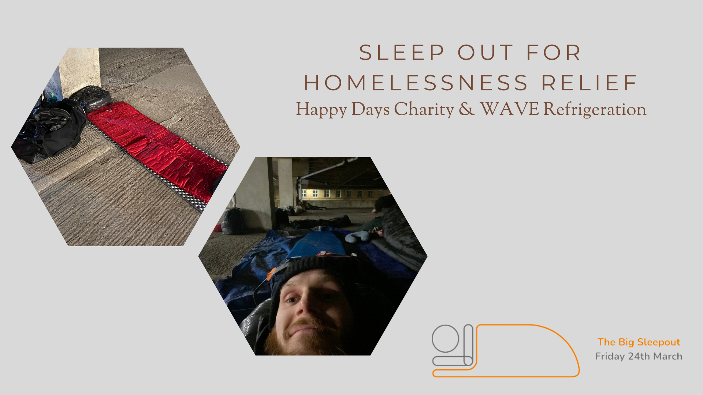
The Big Sleepout (Happy Days UK)
24th March – Sam Cameron
Sam Cameron joined Happy Days UK Charity in their sleep out to raise money. Through Fundraising Sam individually raised £227 for the Charity.
The event was designed to portray the discomfort a homeless person experiences every night. As such, the event lasted from 8pm Friday night until 7am Saturday morning and was held outdoors.
Sam expressed “it was pretty uncomfortable and not much sleep was had. How I feel right now really highlights how those that do this regularly as a necessity must feel ten times worse on a daily basis! No wonder homelessness can be such a spiral without the help of others stepping in, and that’s why what Happy days UK is so important”

Slide 20
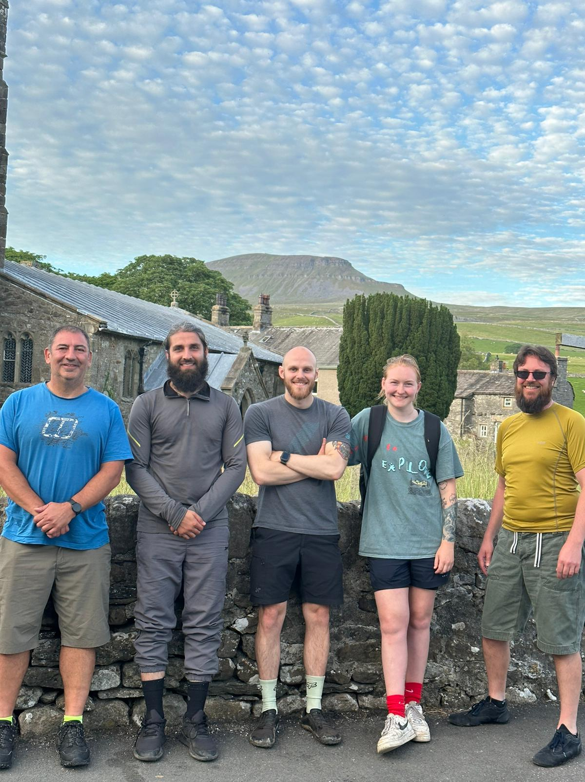
Yorkshire 3 Peaks (Happy Days UK)
26th June – Alan Saban, Sam Cameron, Yousaf Mohammed, and Caitlin Earle
Alan, Yousaf, Cat and Sam took on the mighty Yorkshire Three Peaks. It was a challenging, full day hill/mountain walk in the Yorkshire Dales, 24 miles long and includes the summits Pen-y-Ghent (694m), Whernside (736 m) and Ingleborough (723m).
This was to raise money for our continued support of Happy Days UK. Happy Days operate supported accommodation for 103 residents throughout Calderdale and Kirklees, helping those who have been homeless, are recovering from addictions, have poor mental health, or have been referred via probation services.
Overall, the team managed to raise £775 from combined fundraising for this epic event.

Slide 21
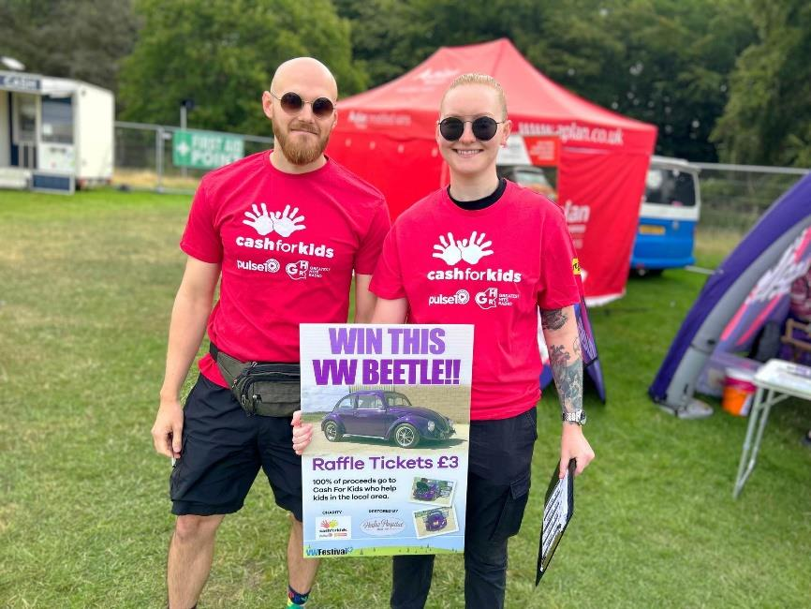
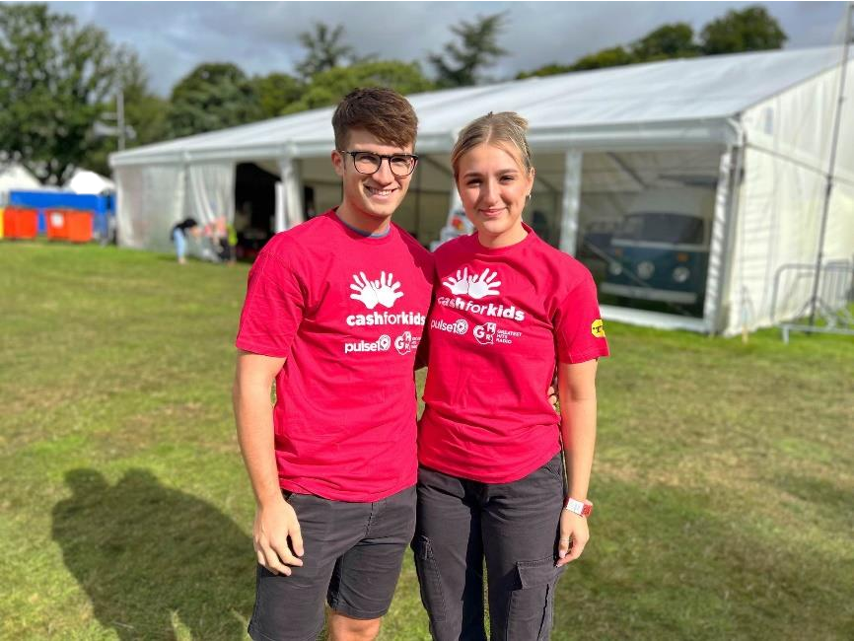
Beetle Raffle Fundraising- VW Festival 2023 (Cash for Kids)
13th August – Sam Cameron, Caitlin Earle and Jack Brockbank
On the 13th of August 2023, Sam, Caitlin, and Jack from WAVE demonstrated their commitment to making a positive impact within their community by volunteering at the VW Festival held at Harewood House in Leeds.
In collaboration with the Cash for Kids charity, they embarked on a fundraising initiative selling tickets for a chance to win a VW Beetle.
As part of a dedicated team, their efforts were instrumental in raising an impressive sum of over £19,000 for the charity. Through their selfless contribution and involvement in this event, Sam, Caitlin, and Jack showcased the values of WAVE and their dedication towards supporting charitable causes.

Slide 22
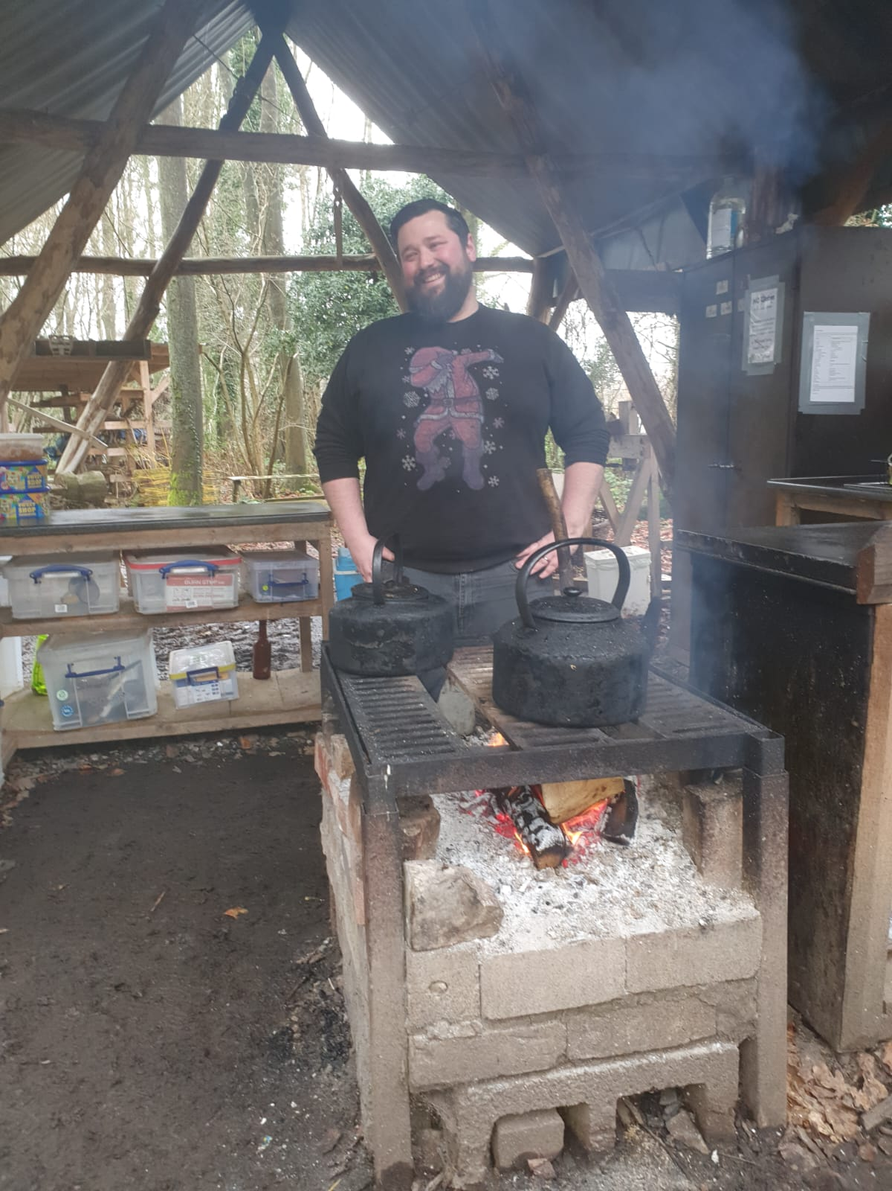
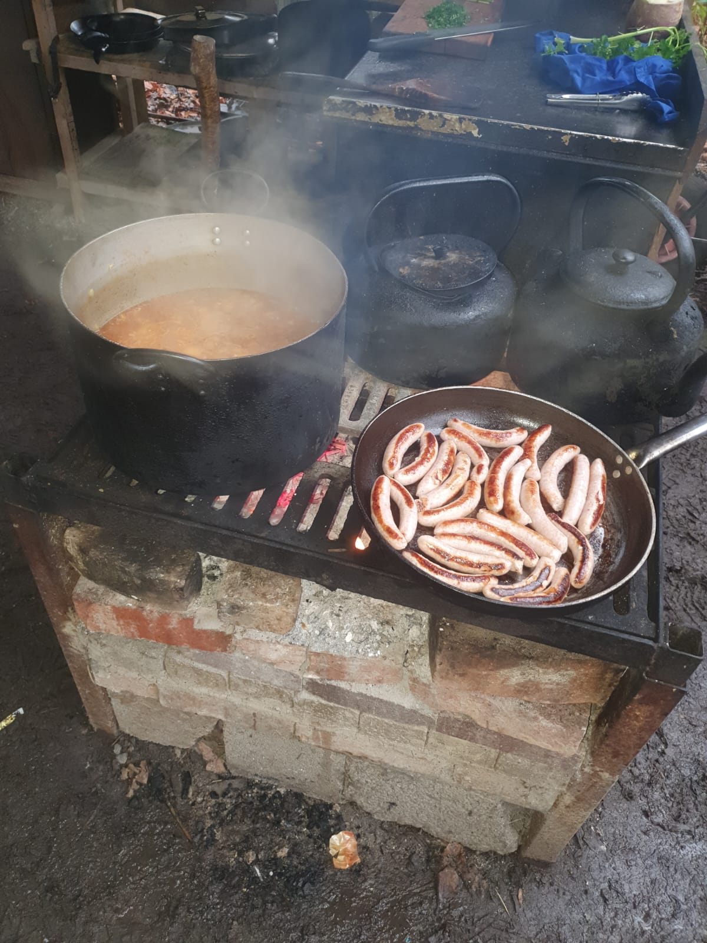
Sou(p)s Chef Mike! Volunteering (The Cart Shed)
19th October to 19th December - Mike Gittoes
The Cart Shed is an organisation dedicated to transforming lives, specifically those facing mental health difficulties. Through woodland activities such as woodcraft and coppice craft as well as horticulture they empower people to self-manage mental and physical health in a sustainable way.
Mike volunteered as a cook, impressively cooking for groups of 15 to 25 people. Mike prepared hearty soups and crafted mouth-watering sausage sandwiches, providing sustenance to the hardworking staff, volunteers, and participants
Mike will continue to volunteer with the charity and will have volunteering days coming up soon. WAVE also plans to support the Cart Shed with further volunteering and support in building new sites and supporting the charities Plant Fair in 2024.

Slide 23
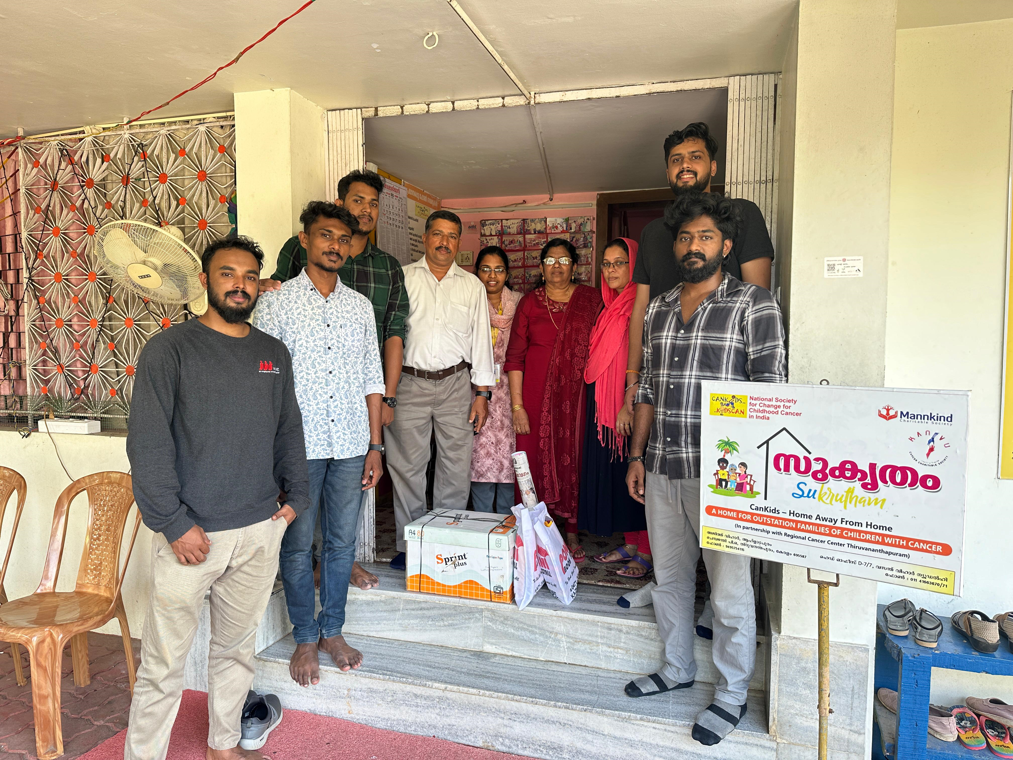
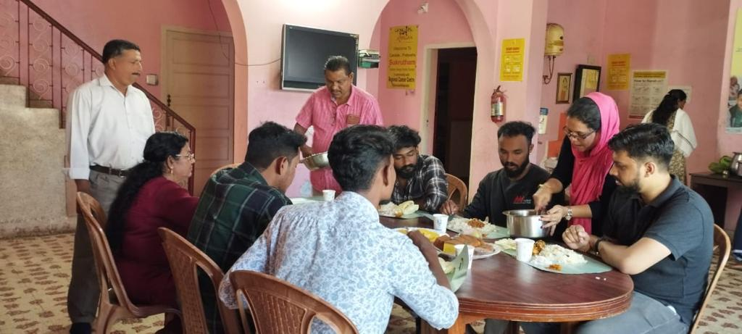
Donations of Books & Food (Shelter for Cancer Kids - Sukrutham)
7th December – Gokul Divakaran, Siva Pillai, Nandu Kumar, Abhay Dev, Fahad Nilofar
On the 7th December 2023, the WAVE Inda team donated books, art supplies and food to the Shelter for Cancer Kids in Sukrutham.
The team also donated lunch and food provisions to alleviate food insecurity, promoting dignity and well-being for the shelter's residents and staff. Their efforts promoted education, addressed hunger, and fostered good health and well-being, empowering individuals and nurturing holistic development.
Their actions serve as a reminder that even small gestures can have a ripple effect, transforming lives and building a more compassionate and connected society.

Slide 24
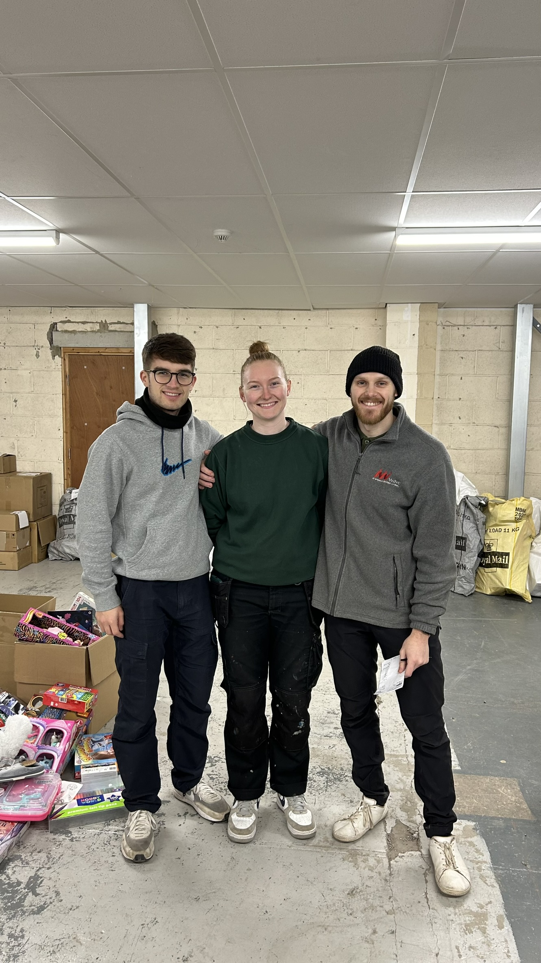
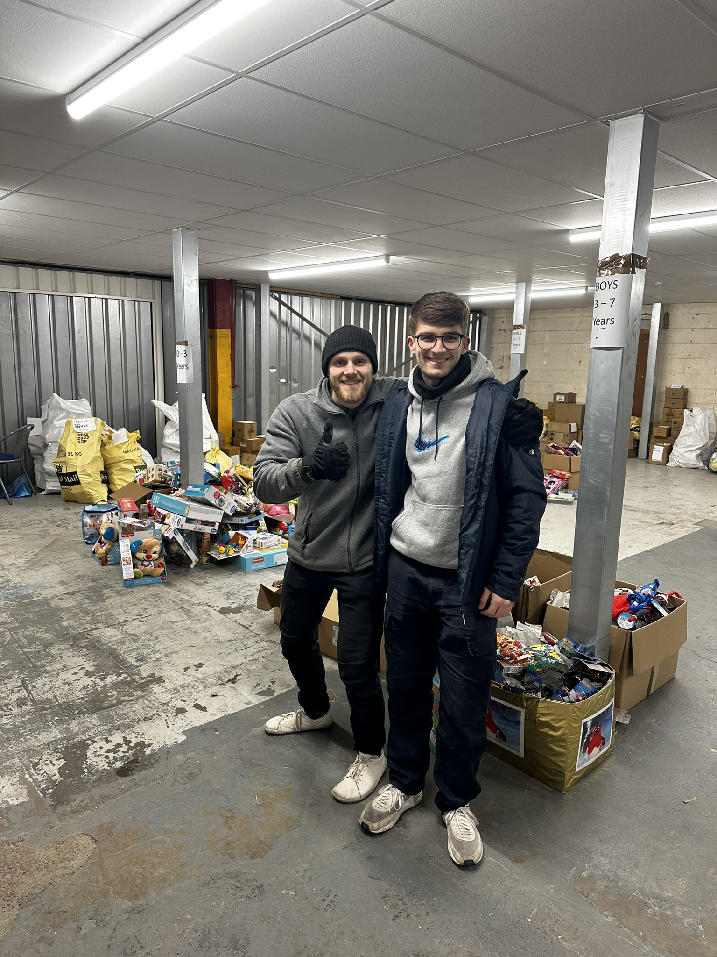
Packing Presents! Mission Christmas (Cash for Kids)
8th December – Sam Cameron, Caitlin Earle, Jack Brockbank
WAVE's incredible team of volunteers, comprising Sam, Caitlin, and Jack, dedicated their time to support the Cash for Kids charity. Their efforts at the Store Room in Leeds brought joy and hope to many children in need this Christmas season.
The volunteering event, aptly named "Mission Christmas," saw the collaboration of Sam, Caitlin, Jack, and the Cash for Kids team. Together, they embarked on the vital task of sorting through generous donations of Christmas gifts. With care and dedication, they ensured that each present was packed and ready to reach the children who need them the most.

Slide 25
Thank you for your support in 2023!
WAVE is incredibly grateful, and we look forward to an exciting 2024 as we continue to grow and thrive.
www.wave-refrigeration.com
info@wave-refrigeration.com
01535 287 032

